Slide 1
EASA FCL Main Changes Applicable from 30 October 2022

Slide 2
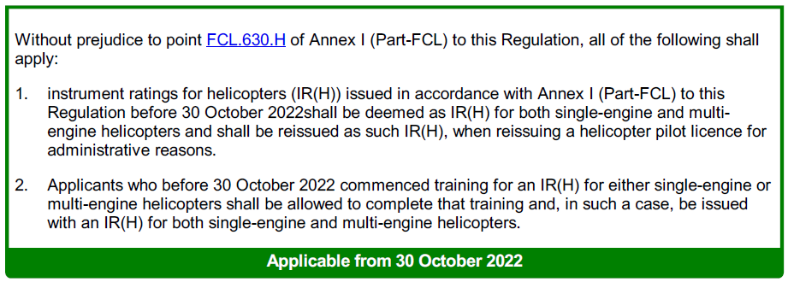
EASA FCL, Main Changes Applicable from 30.10.2022
Article 4d Transitional measures for single-engine instrument rating privileges for helicopters
Last updated: 15-12-2021; Ref: (EU) 2021/2227
Notes:
FCL.630.H IR(H) — Extension of privileges from single-engine to multi-engine helicopters
FCL.630.H IR(H) – Extension of the privileges of an IR(H) to further helicopter types

Slide 3
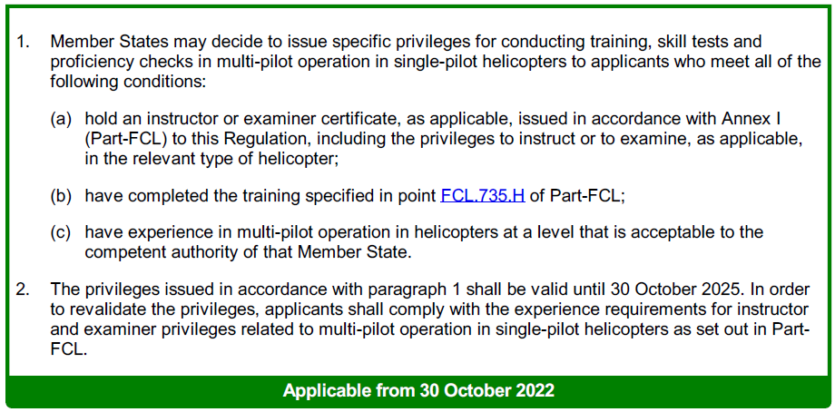
EASA FCL, Main Changes Applicable from 30.10.2022
Article 4e Transitional measures for training, testing and checking related to multi-pilot operations in single-pilot helicopters
Last updated: 15-12-2021; Ref: (EU) 2021/2227
Notes:
FCL.735.H Multi-crew cooperation training course — helicopters
AMC1 FCL.735.A; GM FCL.735.H
The MCC training course shall (a) comprise at least:
(1) for MCC/IR:
(i) 25 hours of theoretical knowledge instruction and exercises; and
20 hours of practical MCC training or 15 hours, in the case of student pilots attending an
ATP(H)/IR integrated course. When the MCC training is combined with the initial type rating
training for a multi- pilot helicopter, the practical MCC training may be reduced to not less
than 10 hours if the same FSTD is used for both MCC and type rating;
(2) for MCC/VFR:
(i) 25 hours of theoretical knowledge instruction and exercises; and
(ii)15 hours of practical MCC training or 10 hours, in the case of student pilots attending an
ATP(H)/IR integrated course. When the MCC training is combined with the initial type rating
training for a multi- pilot helicopter, the practical MCC training may be reduced to not less
than 7 hours if the same FSTD is used for both MCC and type rating.
(b) The MCC training course shall be completed within 6 months at an ATO.
An FNPT II or III qualified for MCC, an FTD 2/3 or an FFS shall be used.
(c) Unless the MCC course has been combined with a multi-pilot type rating course, on completion of the
MCC training course the applicant shall be given a certificate of completion.
(d) An applicant having completed MCC training for any other category of aircraft shall be exempted from
the requirement in (a)(1)(i) or (a)(2)(i), as applicable.
(e) An applicant for MCC/IR training who has completed MCC/VFR training shall be exempted from the
requirement in (a)(1)(i), and shall complete 5 hours of practical MCC/IR training.

Slide 4
EASA FCL, Main Changes Applicable from 30.10.2022
Article 10a Pilot training organisations
Last updated: 15-12-2021; Ref: (EU) 2021/2227

Slide 5
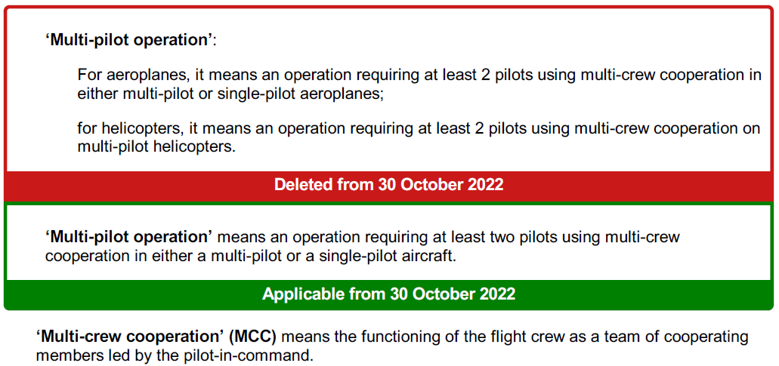
EASA FCL, Main Changes Applicable from 30.10.2022

Slide 6
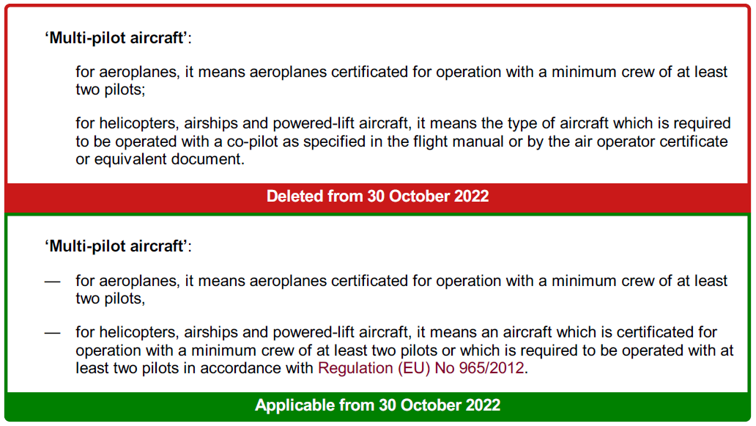
EASA FCL, Main Changes Applicable from 30.10.2022

Slide 7
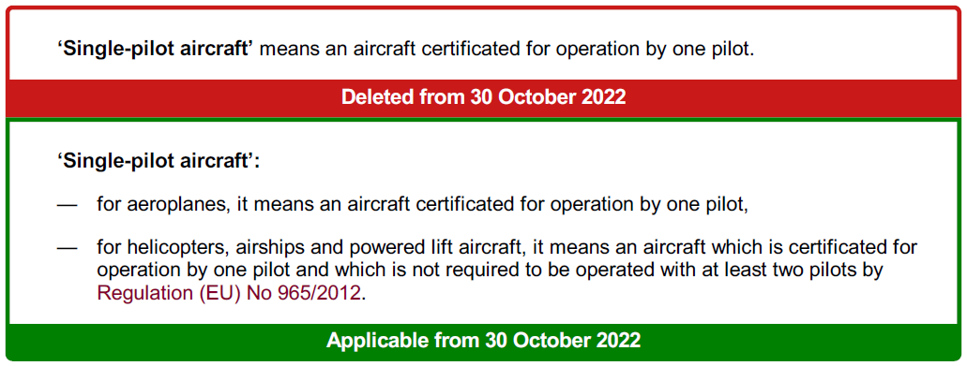
EASA FCL, Main Changes Applicable from 30.10.2022

Slide 8
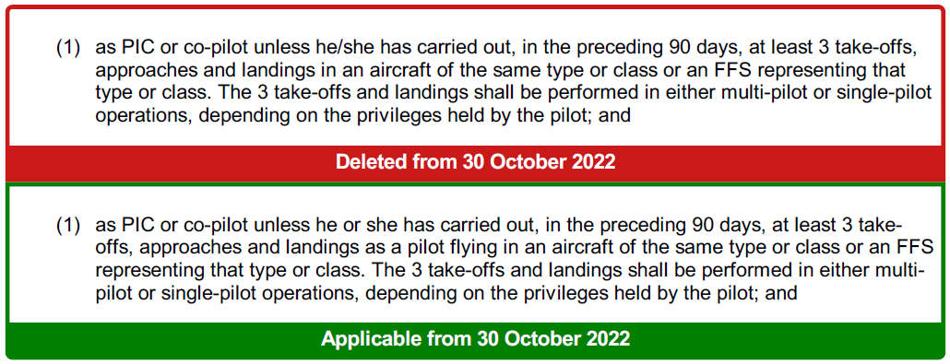
EASA FCL, Main Changes Applicable from 30.10.2022
FCL.060 Recent experience
Last updated: 15-12-2021; Ref: (EU) 2021/2227
(a) "Deleted".
(b) Aeroplanes, helicopters, powered-lift aircraft and airships. A pilot shall not operate an aircraft in
commercial air transport or to carry passengers:

Slide 9
EASA FCL, Main Changes Applicable from 30.10.2022
FCL.310 CPL — Theoretical knowledge examinations
Last updated: 14-12-2018; Ref: (EU) 2018/1974

Slide 10
EASA FCL, Main Changes Applicable from 30.10.2022
FCL.310 CPL — Theoretical knowledge examinations
Last updated: 14-12-2018; Ref: (EU) 2018/1974

Slide 11
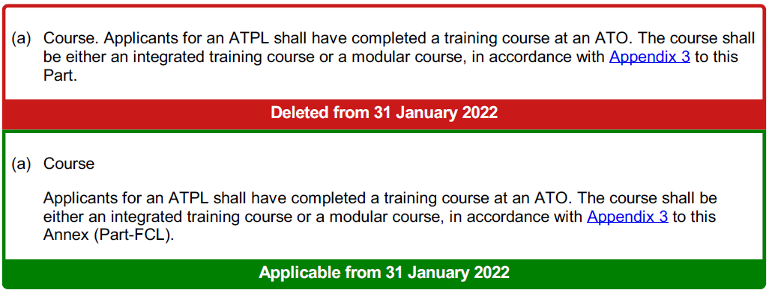
EASA FCL, Main Changes Applicable from 30.10.2022
FCL.515 ATPL — Training course and theoretical knowledge examinations
Last updated: 14-12-2018; Ref: (EU) 2018/1974

Slide 12
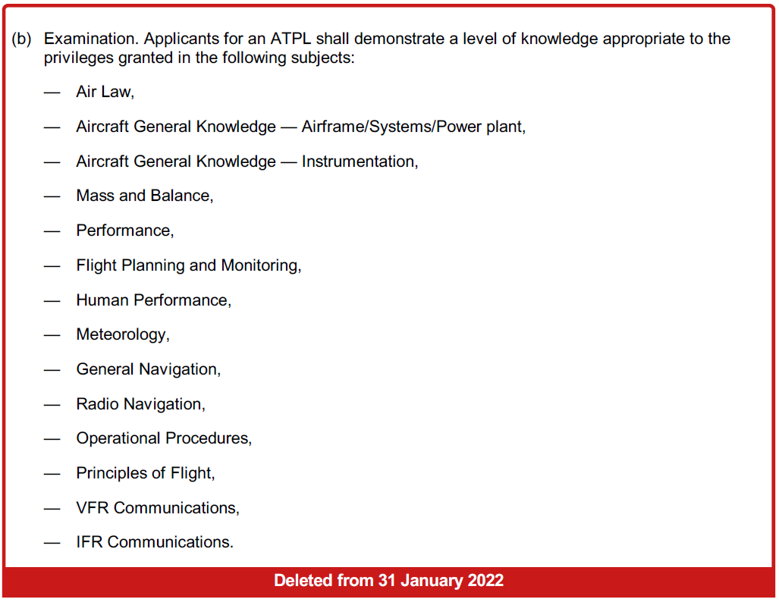
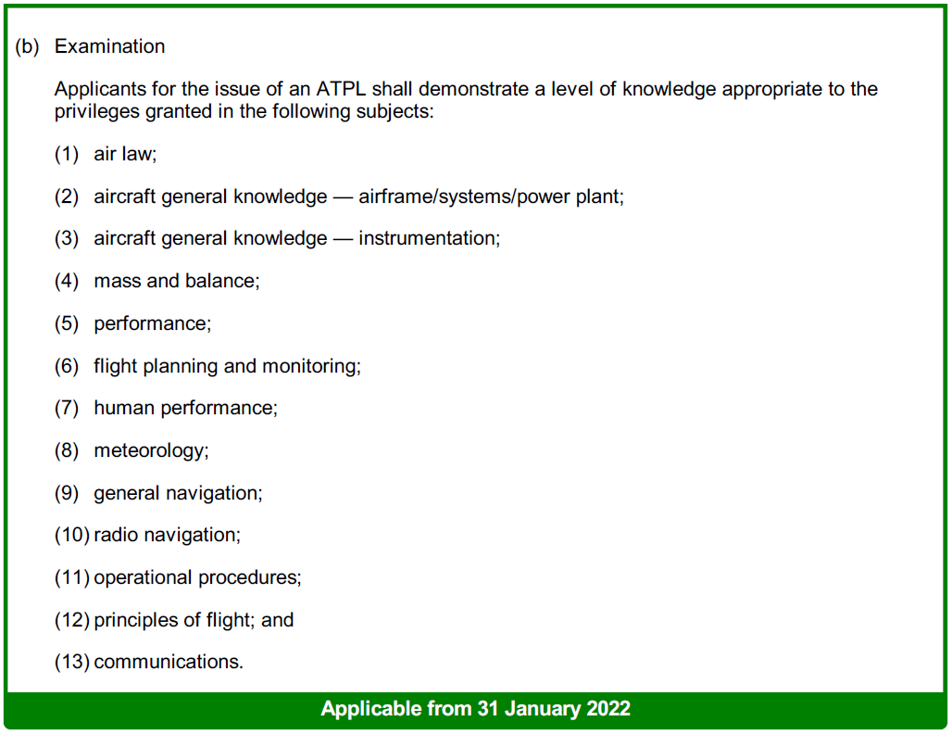
EASA FCL, Main Changes Applicable from 30.10.2022
FCL.515 ATPL — Training course and theoretical knowledge examinations
Last updated: 14-12-2018; Ref: (EU) 2018/1974

Slide 13
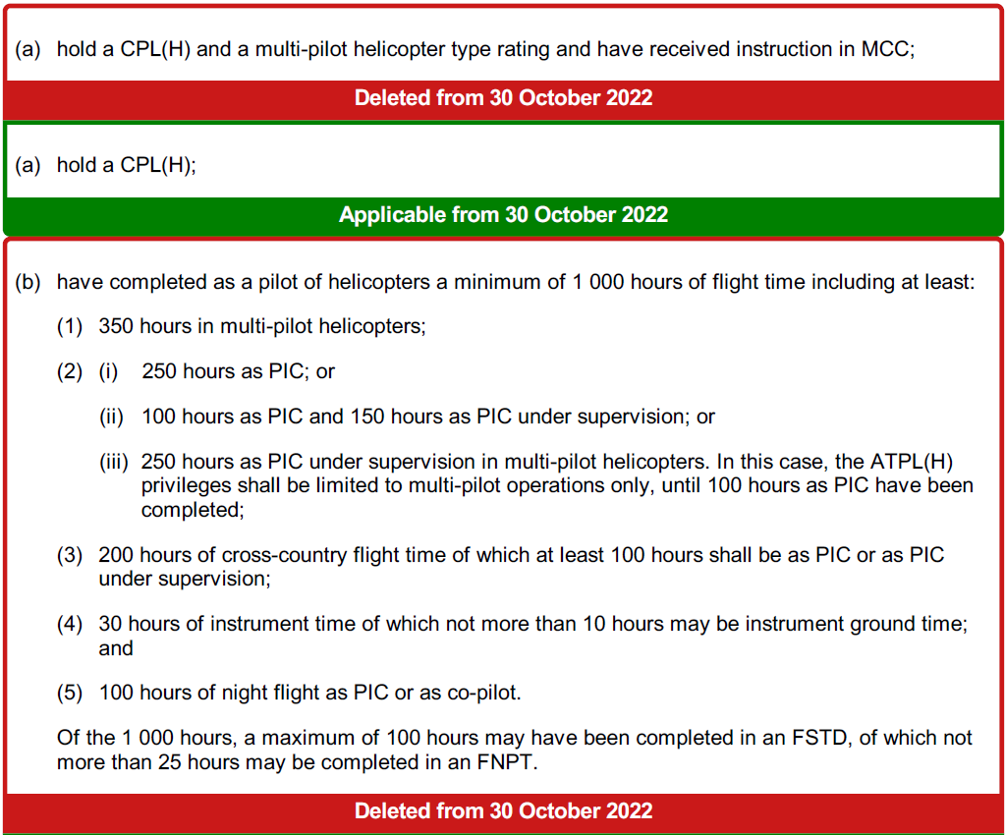
EASA FCL, Main Changes Applicable from 30.10.2022
FCL.510.H ATPL(H) — Prerequisites, experience and crediting
Last updated: 15-12-2021; Ref: (EU) 2021/2227
Applicants for an ATPL(H) shall:

Slide 14
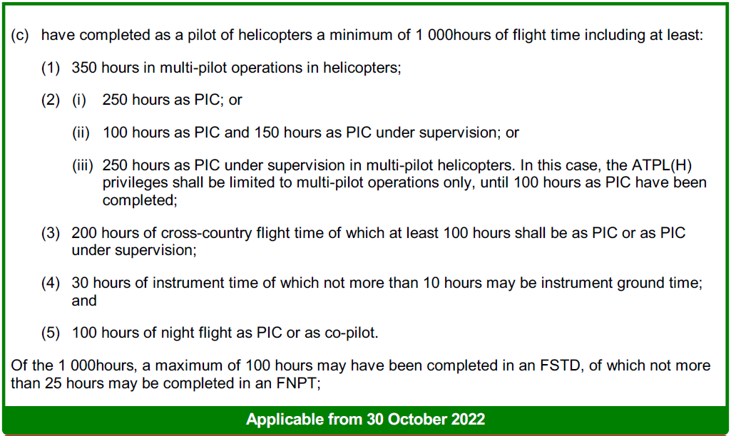
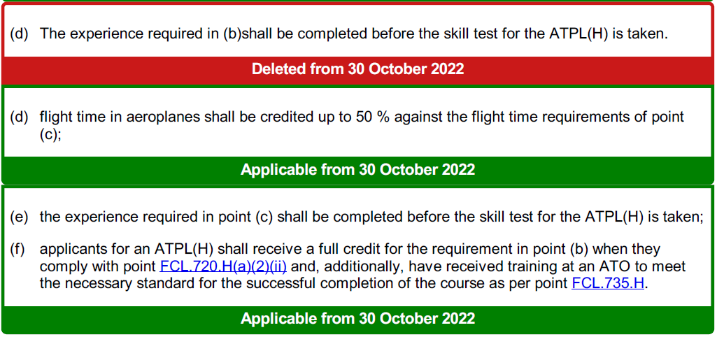
EASA FCL, Main Changes Applicable from 30.10.2022
FCL.510.H ATPL(H) — Prerequisites, experience and crediting
Last updated: 15-12-2021; Ref: (EU) 2021/2227
Applicants for an ATPL(H) shall:

Slide 15
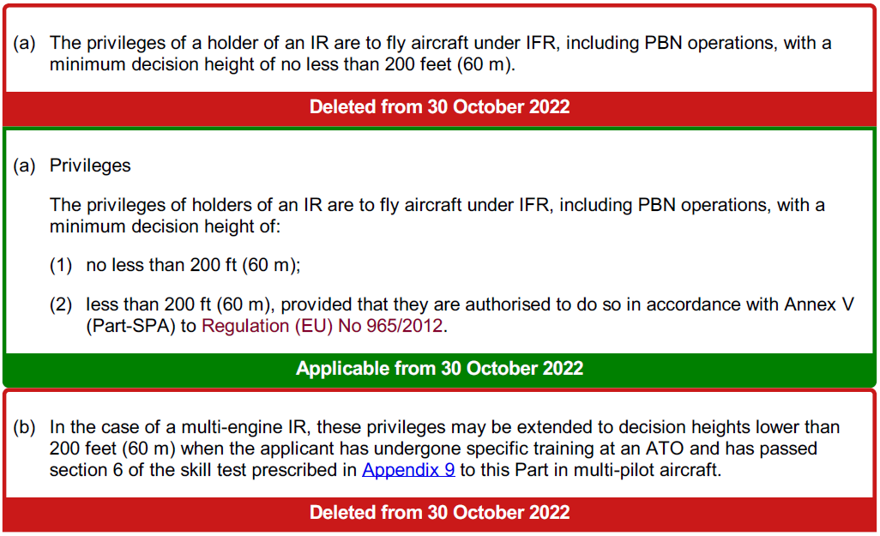
EASA FCL, Main Changes Applicable from 30.10.2022
FCL.605 IR — PrivilegesFCL.605 IR – Privileges and conditions
Last updated: 15-12-2021; Ref: (EU) 2021/2227

Slide 16
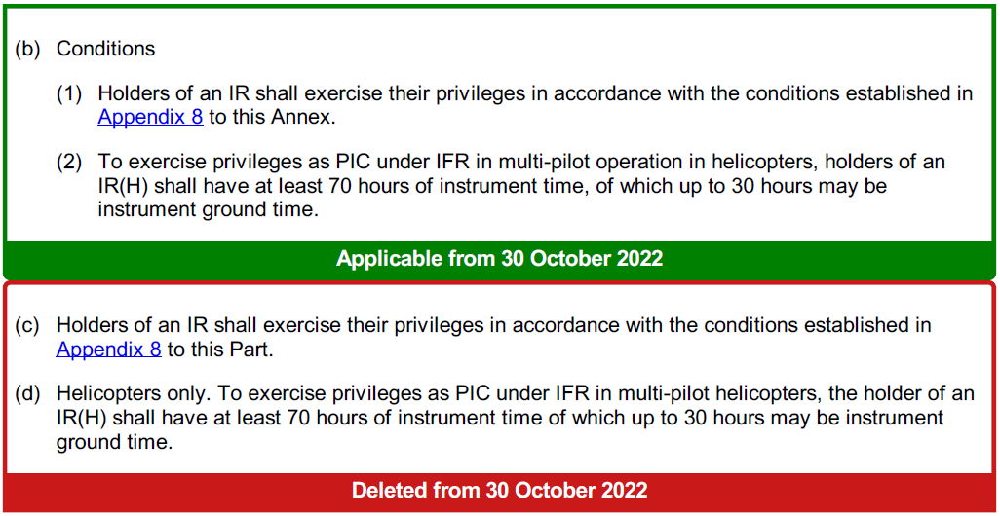
EASA FCL, Main Changes Applicable from 30.10.2022
FCL.605 IR — PrivilegesFCL.605 IR – Privileges and conditions
Last updated: 15-12-2021; Ref: (EU) 2021/2227

Slide 17
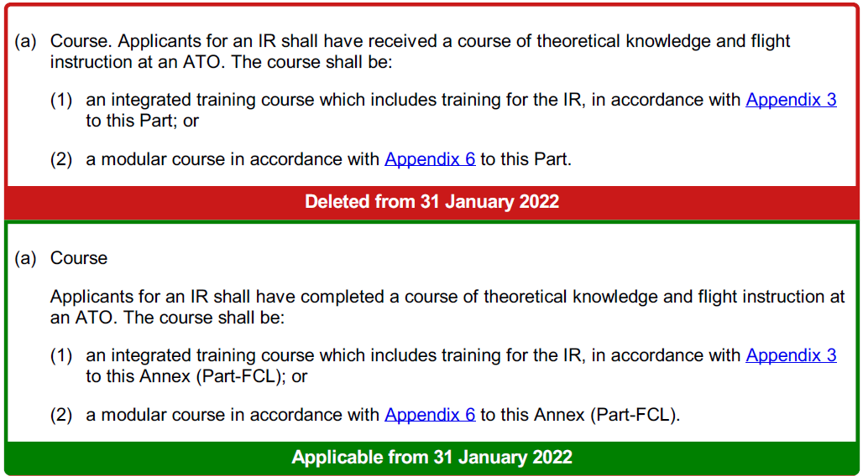
EASA FCL, Main Changes Applicable from 30.10.2022
FCL.615 IR — Theoretical knowledge and flight instruction
Last updated: 14-12-2018; Ref: (EU) 2018/1974

Slide 18
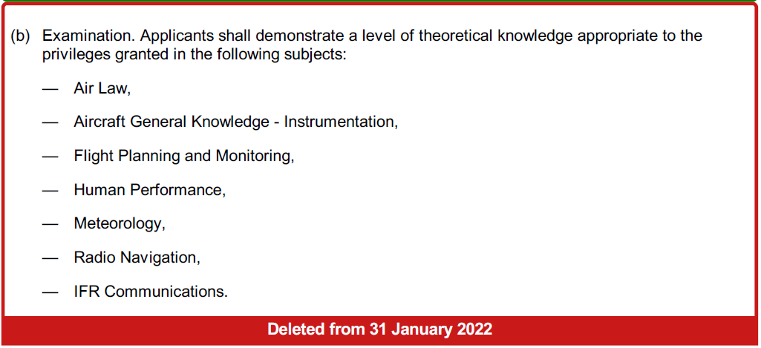
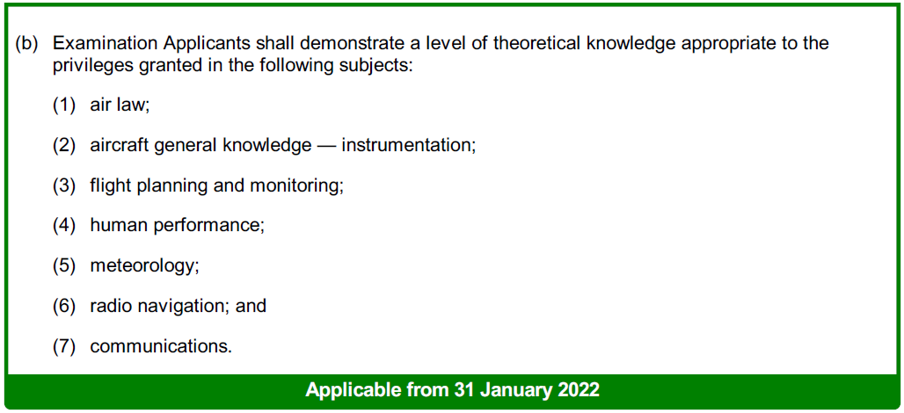
EASA FCL, Main Changes Applicable from 30.10.2022
FCL.615 IR — Theoretical knowledge and flight instruction
Last updated: 14-12-2018; Ref: (EU) 2018/1974

Slide 19
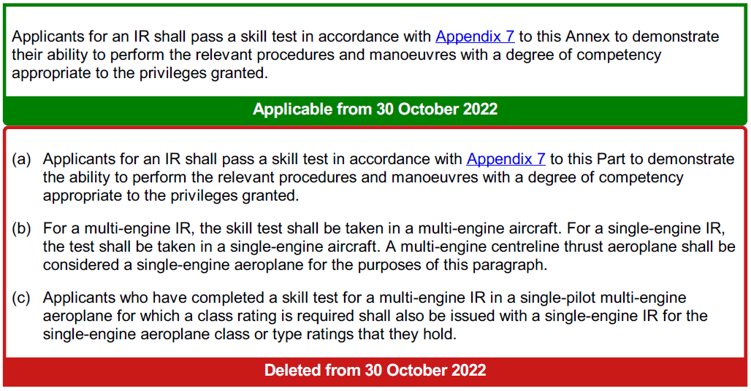
EASA FCL, Main Changes Applicable from 30.10.2022
FCL.620 IR — Skill test
Last updated: 15-12-2021; Ref: (EU) 2021/2227

Slide 20
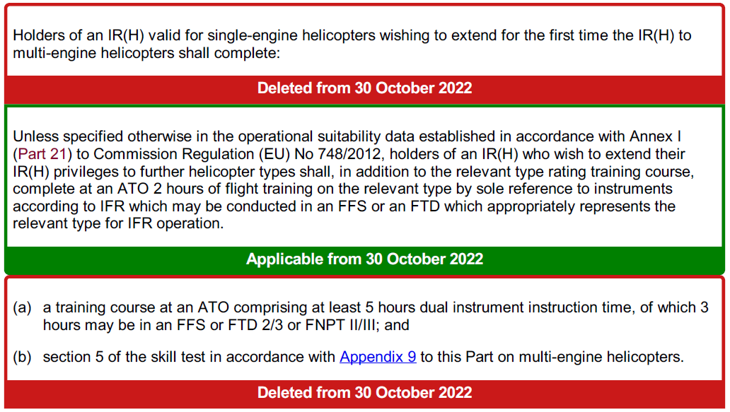
EASA FCL, Main Changes Applicable from 30.10.2022
FCL.630 IR — Extension of privileges from single-engine to multi-engine helicopters
FCL.630 IR– Extension of the privileges of an IR(H) to further helicopter types
Last updated: 15-12-2021; Ref: (EU) 2021/2227

Slide 21
EASA FCL, Main Changes Applicable from 30.10.2022
FCL.725 Requirements for the issue of class and type ratings
Last updated: 15-12-2021; Ref: (EU) 2021/2227

Slide 22
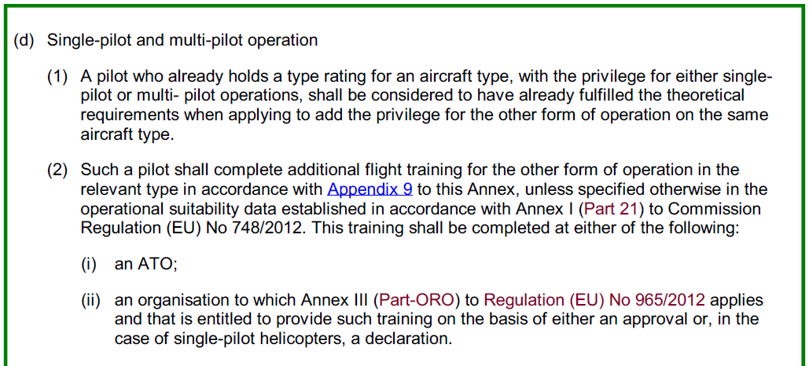
EASA FCL, Main Changes Applicable from 30.10.2022
FCL.725 Requirements for the issue of class and type ratings
Last updated: 15-12-2021; Ref: (EU) 2021/2227

Slide 23
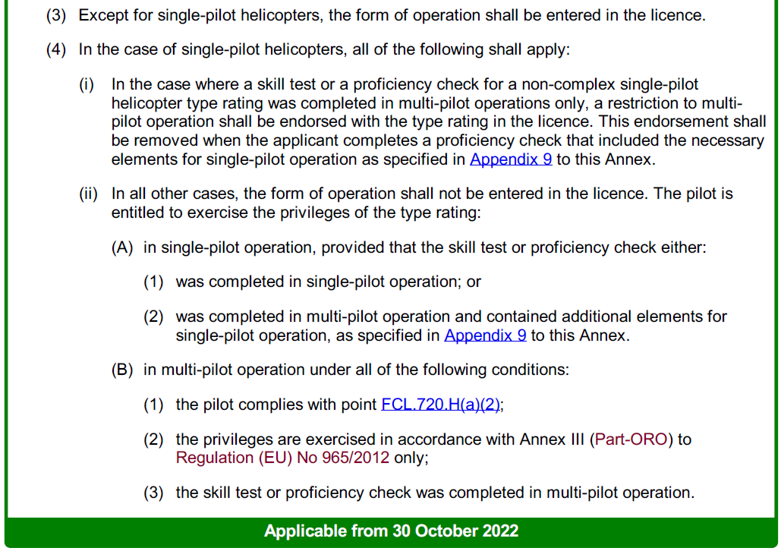
EASA FCL, Main Changes Applicable from 30.10.2022
FCL.725 Requirements for the issue of class and type ratings
Last updated: 15-12-2021; Ref: (EU) 2021/2227

Slide 24
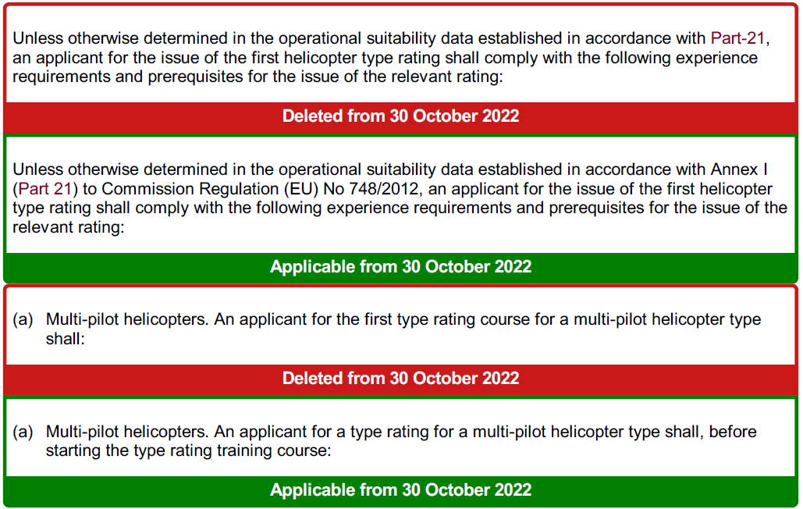
EASA FCL, Main Changes Applicable from 30.10.2022
FCL.720.H Experience requirements and prerequisites for the issue of type ratings — helicopters
Last updated: 15-12-2021; Ref: (EU) 2021/2227

Slide 25
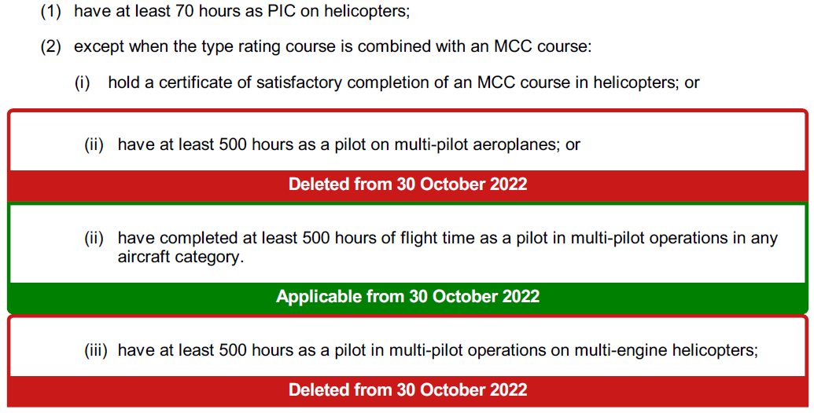
EASA FCL, Main Changes Applicable from 30.10.2022
FCL.720.H Experience requirements and prerequisites for the issue of type ratings — helicopters
Last updated: 15-12-2021; Ref: (EU) 2021/2227

Slide 26
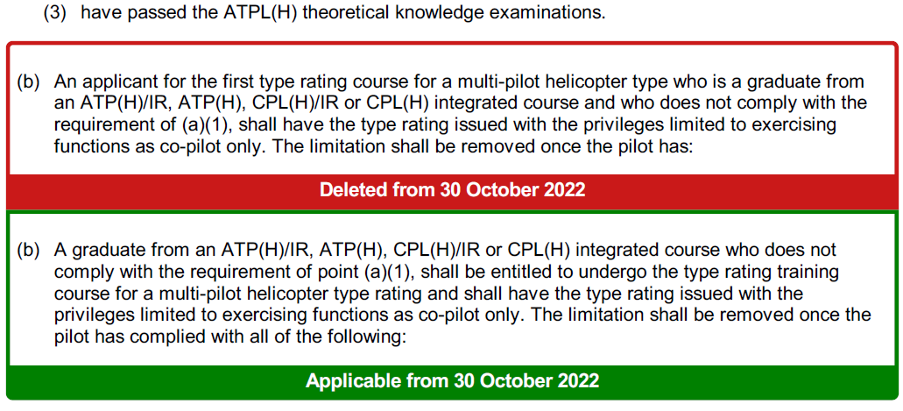
EASA FCL, Main Changes Applicable from 30.10.2022
FCL.720.H Experience requirements and prerequisites for the issue of type ratings — helicopters
Last updated: 15-12-2021; Ref: (EU) 2021/2227

Slide 27
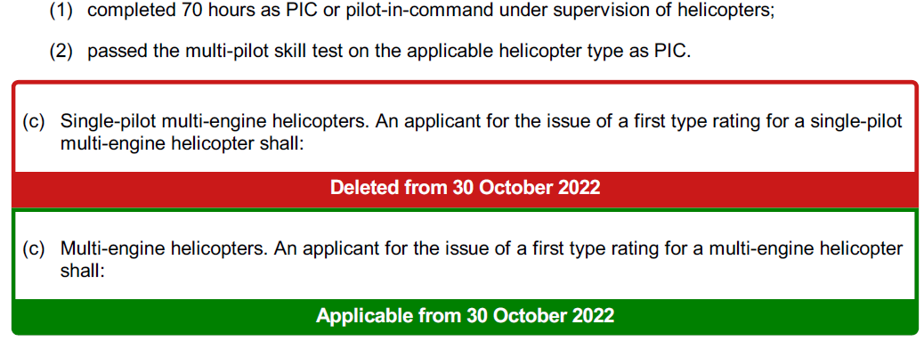
EASA FCL, Main Changes Applicable from 30.10.2022
FCL.720.H Experience requirements and prerequisites for the issue of type ratings — helicopters
Last updated: 15-12-2021; Ref: (EU) 2021/2227

Slide 28
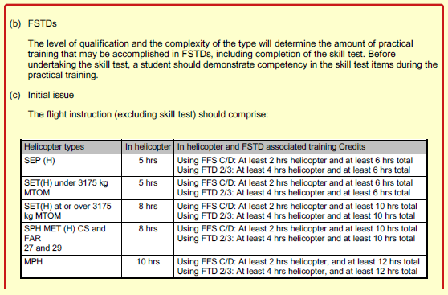
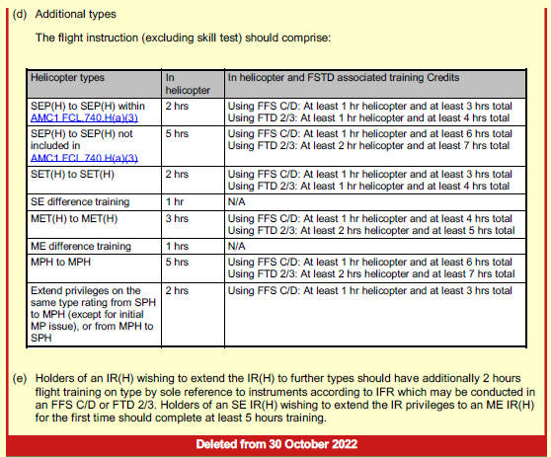
EASA FCL, Main Changes Applicable from 30.10.2022
AMC2 FCL.725(a) Requirements for the issue of class and type ratings
Last updated: 18-08-2022; Ref: ED Decision 2022/014/R

Slide 29
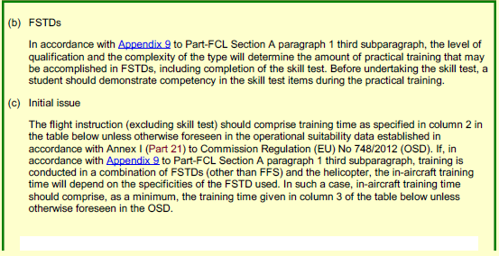
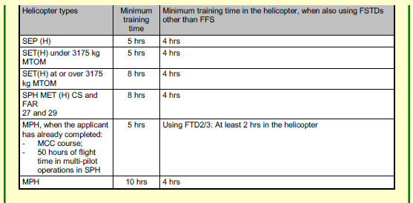
EASA FCL, Main Changes Applicable from 30.10.2022
AMC2 FCL.725(a) Requirements for the issue of class and type ratings
Last updated: 18-08-2022; Ref: ED Decision 2022/014/R

Slide 30
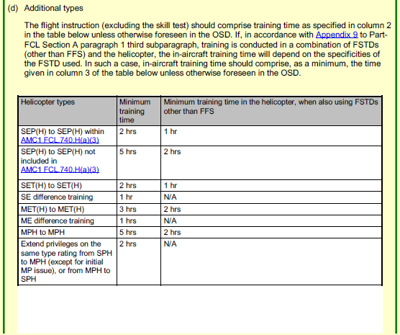
EASA FCL, Main Changes Applicable from 30.10.2022
AMC2 FCL.725(a) Requirements for the issue of class and type ratings
Last updated: 18-08-2022; Ref: ED Decision 2022/014/R

Slide 31
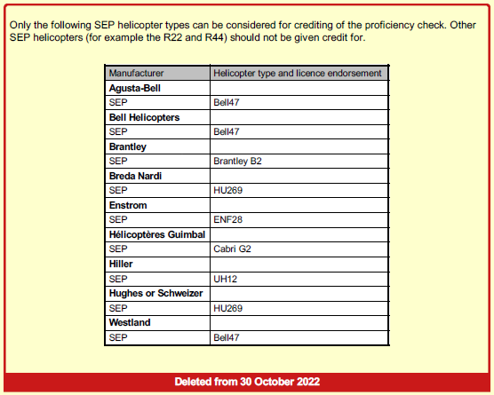
EASA FCL, Main Changes Applicable from 30.10.2022
AMC1 FCL.740.H(a)(3) Revalidation of type ratings — helicopters
Last updated: 18-08-2022; Ref: ED Decision 2022/014/R

Slide 32
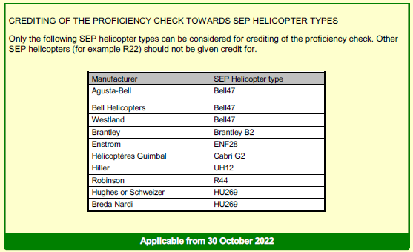
EASA FCL, Main Changes Applicable from 30.10.2022
AMC1 FCL.740.H(a)(3) Revalidation of type ratings — helicopters
Last updated: 18-08-2022; Ref: ED Decision 2022/014/R

Slide 33
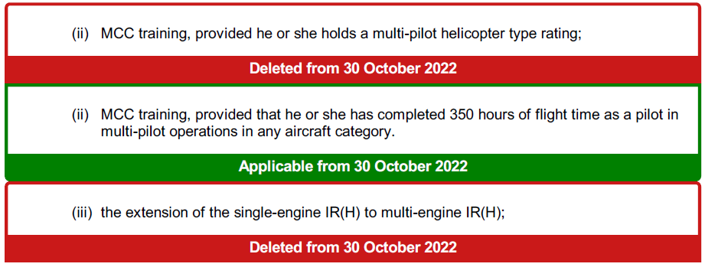
EASA FCL, Main Changes Applicable from 30.10.2022
FCL.905.TRI TRI — Privileges and conditions
Last updated: 15-12-2021; Ref: (EU) 2021/2227
(5) in the case of the TRI for helicopters:
(i) the issue, revalidation and renewal of helicopter type ratings;

Slide 34
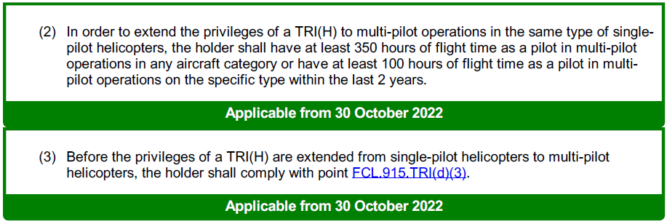
EASA FCL, Main Changes Applicable from 30.10.2022
FCL.910.TRI TRI — Restricted privileges
Last updated: 15-12-2021; Ref: (EU) 2021/2227
(c) TRIs for helicopters (c) — TRI(H).

Slide 35
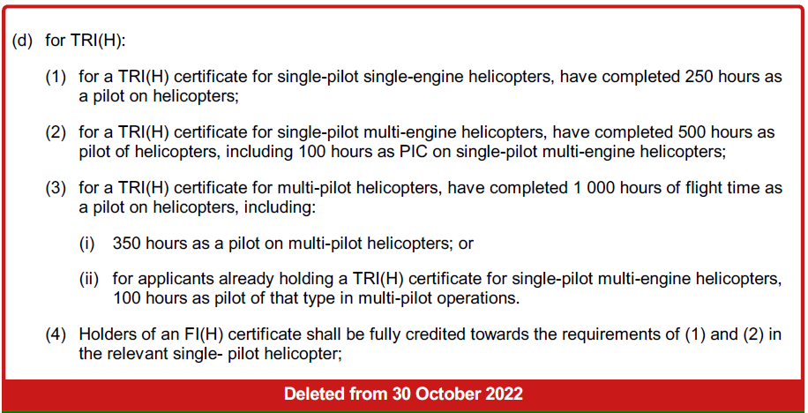
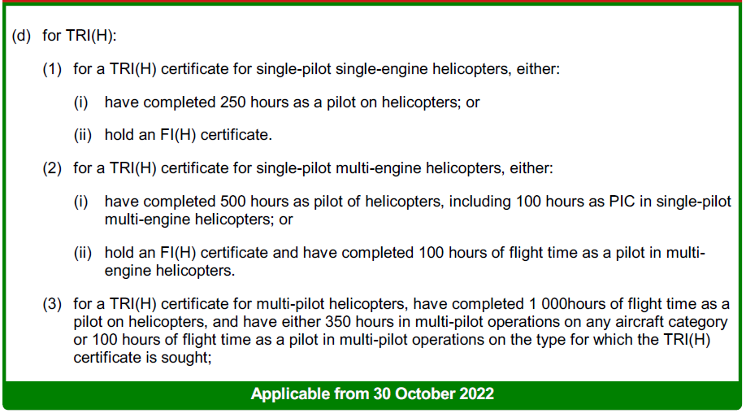
EASA FCL, Main Changes Applicable from 30.10.2022
FCL.915.TRI TRI — Prerequisites
Last updated: 15-12-2021; Ref: (EU) 2021/2227

Slide 36
EASA FCL, Main Changes Applicable from 30.10.2022
FCL.915.IRI IRI — Prerequisites
Last updated: 15-12-2021; Ref: (EU) 2021/2227
(b) for an IRI(H):

Slide 37
EASA FCL, Main Changes Applicable from 30.10.2022
FCL.905.SFI — Privileges and conditions
Last updated: 15-12-2021; Ref: (EU) 2021/2227
(d) The privileges of SFIs for helicopters are to carry out synthetic flight instruction for:

Slide 38
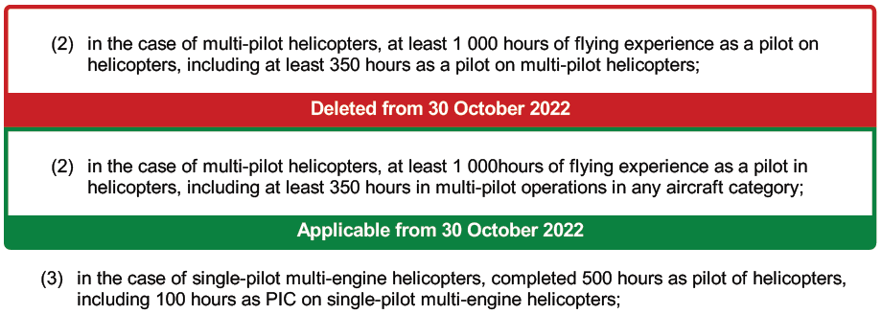
EASA FCL, Main Changes Applicable from 30.10.2022
FCL.915.SFI SFI — Prerequisites
Last updated: 15-12-2021; Ref: (EU) 2021/2227
(e) : additionally, for an SFI(H), have

Slide 39
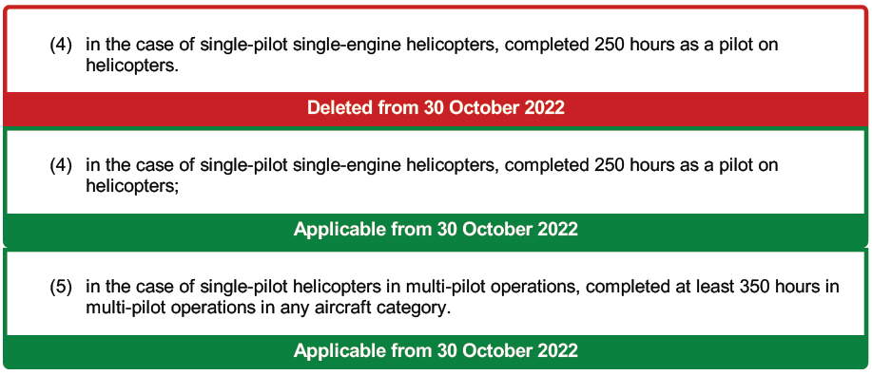
EASA FCL, Main Changes Applicable from 30.10.2022
FCL.915.SFI SFI — Prerequisites
Last updated: 15-12-2021; Ref: (EU) 2021/2227
(e) : additionally, for an SFI(H), have

Slide 40
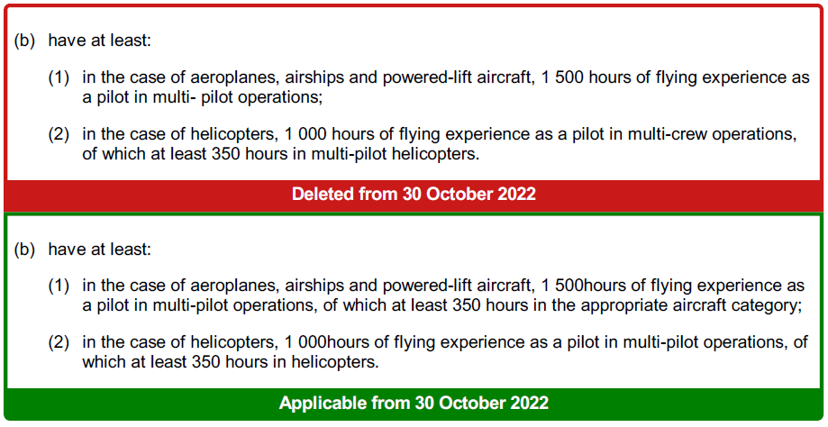
EASA FCL, Main Changes Applicable from 30.10.2022
FCL.915.MCCI MCCI — Prerequisites
Last updated: 15-12-2021; Ref: (EU) 2021/2227
(a) : hold or have held a CPL, MPL or ATPL in the appropriate aircraft category;

Slide 41
EASA FCL, Main Changes Applicable from 30.10.2022
SPECIFIC REQUIREMENTS FOR TYPE RATING EXAMINERS — TRE
FCL.1005.TRE TRE — Privileges and conditions
Last updated: 15-12-2021; Ref: (EU) 2021/2227
(b) TRE(H). The privileges of a TRE(H) are to conduct:
(1) skill tests and proficiency checks for the issue, revalidation or renewal of helicopter type ratings;

Slide 42
EASA FCL, Main Changes Applicable from 30.10.2022
FCL.1010.TRE TRE — Prerequisites
Last updated: 15-12-2021; Ref: (EU) 2021/2227
(b) TRE(H). Applicants for a TRE (H) certificate for helicopters shall:

Slide 43
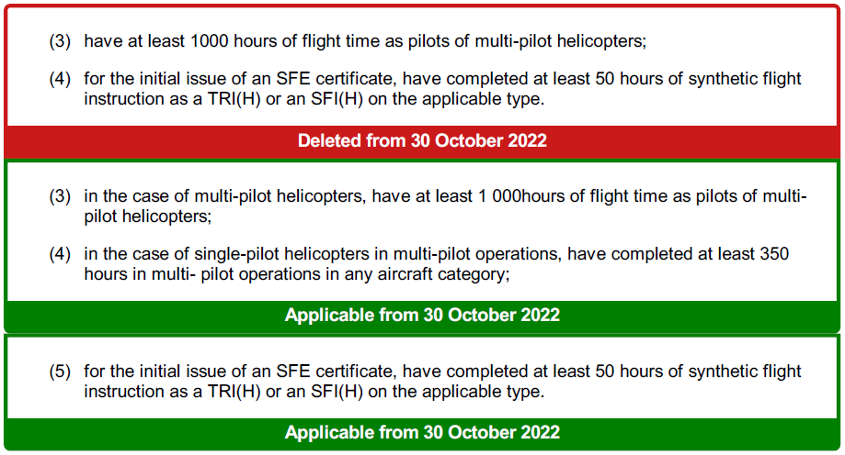
EASA FCL, Main Changes Applicable from 30.10.2022
FCL.1010.SFE Prerequisites
Last updated: 15-12-2021; Ref: (EU) 2021/2227
(b) SFE(H)

Slide 44
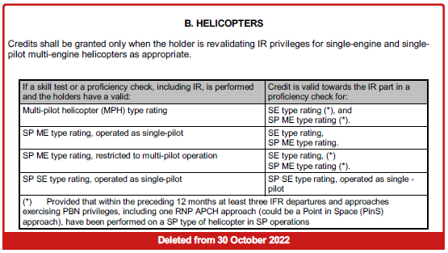
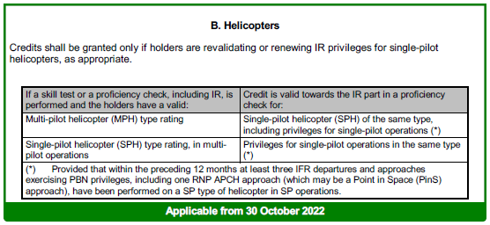
EASA FCL, Main Changes Applicable from 30.10.2022
Appendix 8: CROSS-CREDITING OF THE IR PART OF A CLASS OR TYPE RATING PROFICIENCY CHECK
Last updated: 15-12-2021; Ref: (EU) 2021/2227

Slide 45
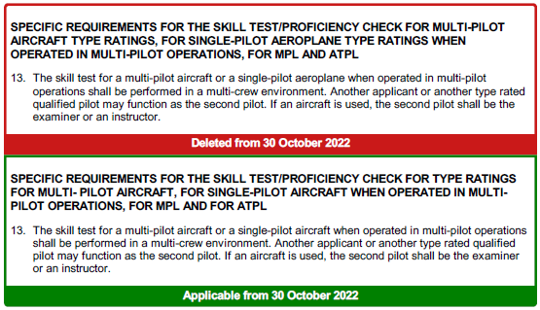
EASA FCL, Main Changes Applicable from 30.10.2022
Appendix 9: TRAINING, SKILL TEST AND PROFICIENCY CHECK FOR MPL, ATPL, TYPE AND CLASS RATINGS, AND PROFICIENCY CHECK FOR THE BIR AND IR
Last updated: 15-12-2021; Ref: (EU) 2021/2227

Slide 46
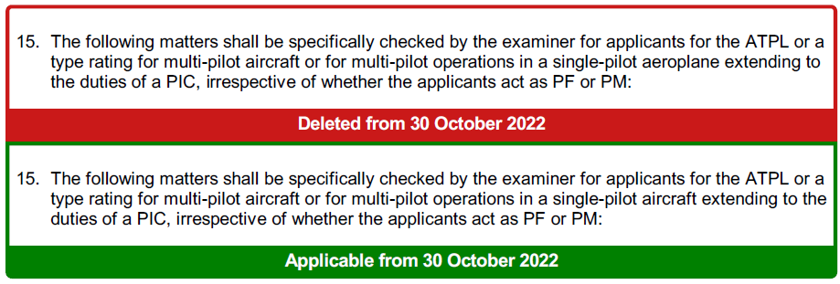
EASA FCL, Main Changes Applicable from 30.10.2022
Appendix 9: TRAINING, SKILL TEST AND PROFICIENCY CHECK FOR MPL, ATPL, TYPE AND
CLASS RATINGS, AND PROFICIENCY CHECK FOR THE BIR AND IR
Last updated: 15-12-2021; Ref: (EU) 2021/2227

Slide 47
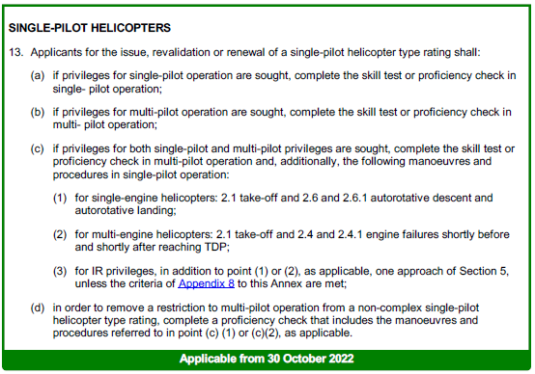
EASA FCL, Main Changes Applicable from 30.10.2022

Slide 48
EASA FCL, Main Changes Applicable from 30.10.2022

